Slide 1
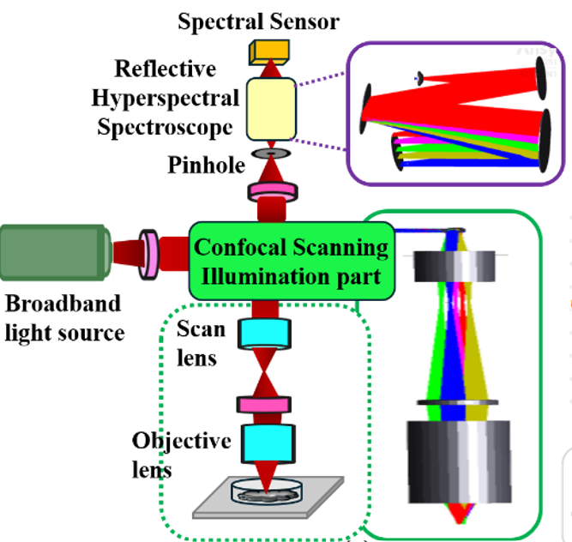
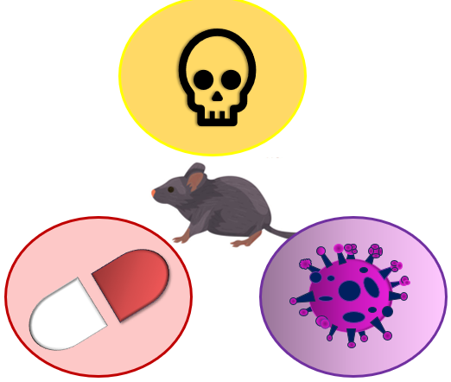
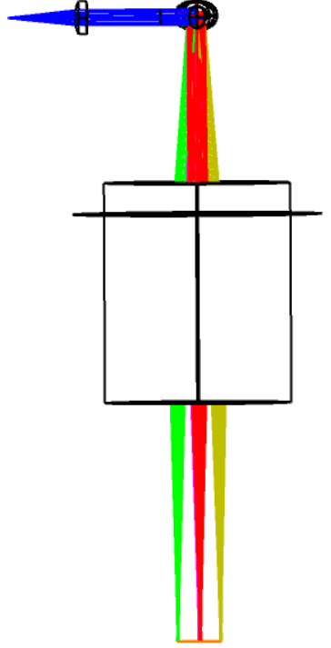
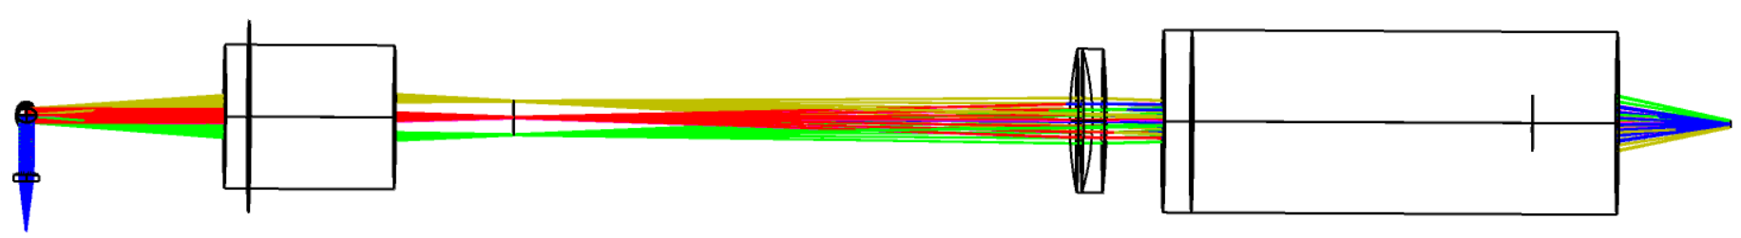




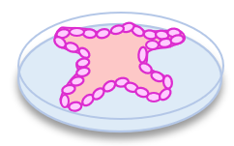
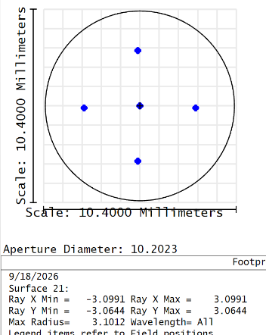
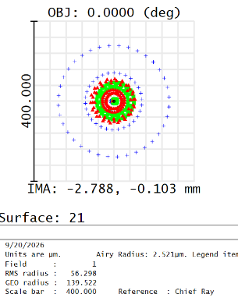
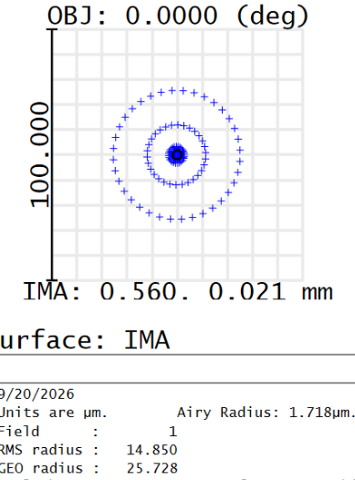
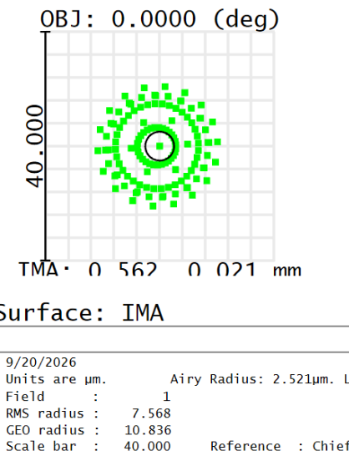
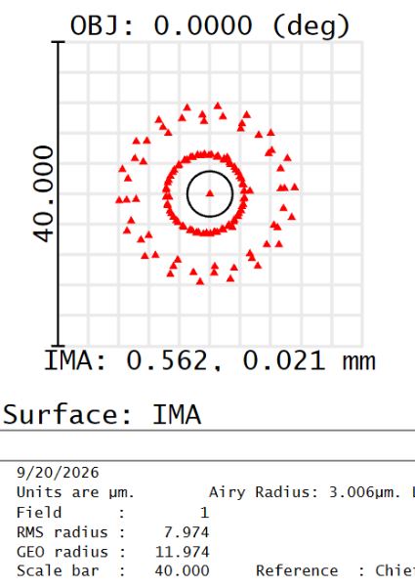
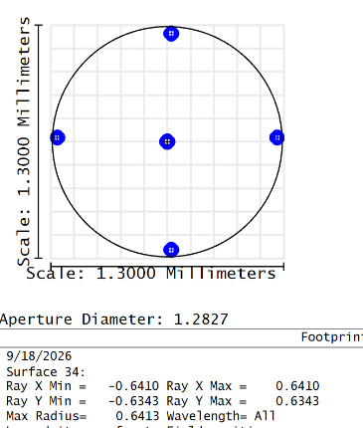
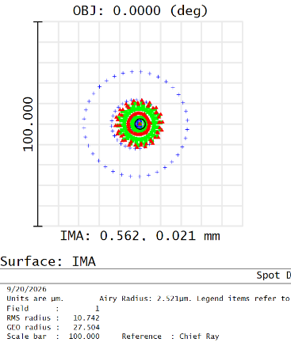

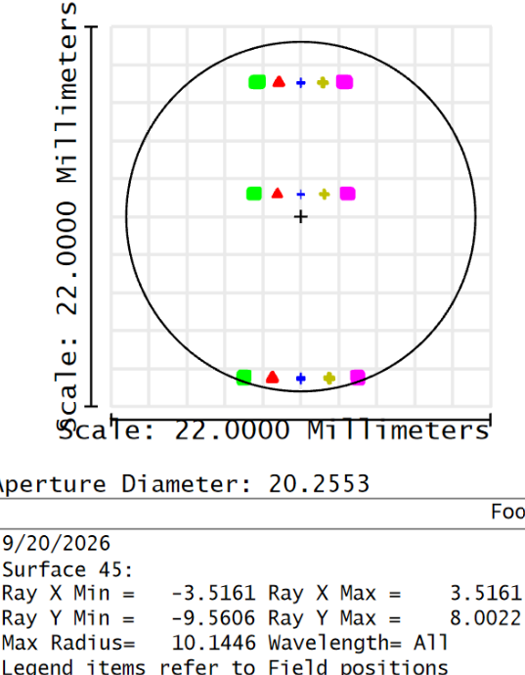
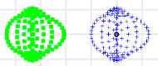
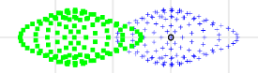
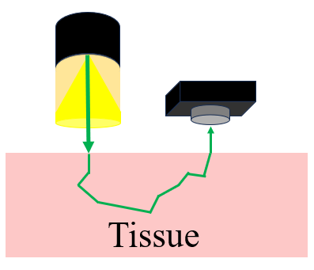
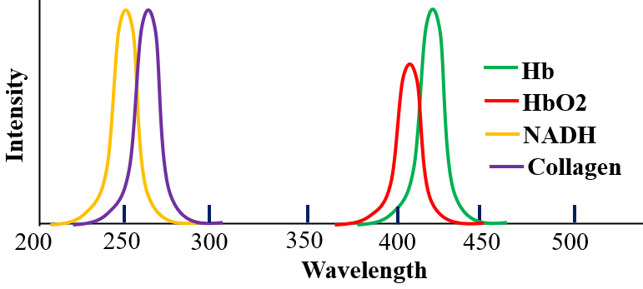
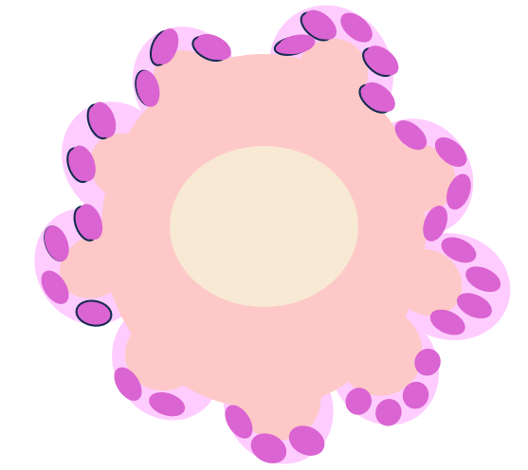
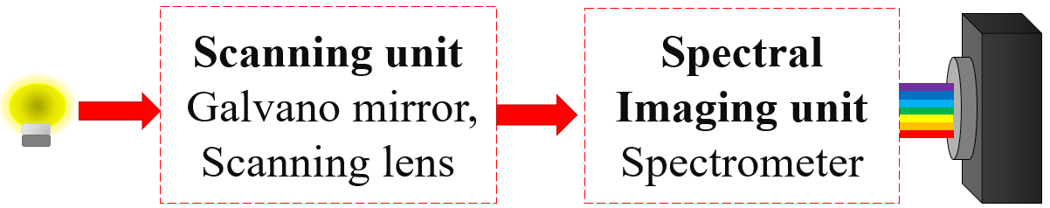
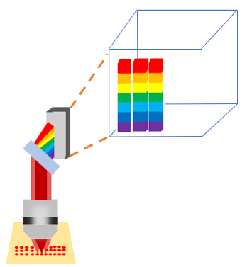
Design of a Confocal Hyperspectral Scanning Microscope for
Label-Free Multiscale Structural and Spectral Imaging
¹Pratik Dhar and ^{2, #}Suchandra Banerjee
^{1,2} Amity Institute of Applied Science, Amity University, Noida, Uttar Pradesh
Introduction
Design of Hyperspectral Microscope
Testing a newly developed drug, toxicology, disease modelling usually done in animal model before testing in human.
Design Specifications
The system utilizes visible range from 400-700 nm.
System comprises dual axis mirror configuration for
scanning.
Switchable multiscale imaging with FOV from 1.4 mm to 10.4 mm.
10x, 0.25 NA objective lens provides multiscale imaging.
The designed spectrometer utilizes 600lines/mm grating & 20 µm × 1 mm slit size.
The contrasting biological nature of animals and human the results appears different.
Organoids monitoring has emerged a promising platform for drug testing, drug delivery, personalized medicine.
Animal Models
What is Organoid?
A lab grown tissue from stem cell that mimics the function of real organs
Fig 1(a) Optical layout and design of confocal hyperspectral scanning microscope system
Fig 1(b) Showing the designed system’s multiscale imaging capability
Organs
Adult Tissue
Adult Cell
Adult cell in 3d embedded matrix
3d Organoid
Result & Discussion
Testing of drugs and disease modelling on organoid can be understand by monitoring the morphological response & functional response.
2(a)
2(b)
2(e)
Morphological Biomarkers
Functional/Spectral Biomarkers
Perimeter
Feret’s diameter
Roundness
Inflection points
Texture
Albumin
NADH, FAD
Collagen, Tryptophan
Oxyhemoglobin and Deoxyhemoglobin
Conventional Existing Imaging system
Fig 2(a)Footprint diagram of field of view (FOV) 10.4mm X 10.4mm of scan lens at image plane and 2(b) giving spatial resolution about 56.2 um.
Fig 2(e) Spot diagram of on the image plane after the microscope objective for three wavelength
Fluorescence Microscopy captures fluorophore specific
wavelengths
makes the method sample specific
Scanning Electron Microscopy provides only the structural
information
Raman Spectroscopy slow scanning acquisition, takes
hour to scan an area on micrometer scale
Filter based HSI band-by-band filtering
low spectral resolution
Snapshot imaging spatial-spectral resolution trade-off
Colorimetric assay destructive method
doesn’t provide spatial information
2(c)
2(d)
3(a)
3(b)
0.400 0.406
Current label-free imaging methods fails to capture both the spatial and spectral properties of living organoids simultaneously
0.587 0.593
Fig 2(c)Footprint diagram of field of view (FOV) 1.4mm X 1.4mm of microscope objective at image plane and 2(d) giving spatial resolution about 10.742 um
0.694 0.700
Objective
To design a label free, imaging system for simultaneous acquisition of structural and biochemical/spectral information from organoid.
ZEMAX designed demonstrates the integration of 2D galvo scanning, imaging optics, and spectral detection in a single system.
The design provides hyperspectral imaging with a scalable 1.4–10 mm FOV for multiscale imaging.
The designed spectrometer with a 600 lines/mm grating enables wavelength-resolved detection for label-free imaging.
Fig 3(a) the footprint diagram of whole system representing the hyperspectral imaging capability of designed system & 3(b) the spot sizes of two adjacent wavelength with 6nm separation are well resolved, representing the spectral resolution of designed HSI system
Methodology
HSI captures diffuse reflected light
Contains information about structural
and spectral features
Light source
HSI Camera
(a)
(b)
The inhomogeneous size and shape of constituent particle is responsible for scattering phenomenon
Conclusion
Fig (a) the reflectance spectra (b) the image of an organoid
Here we have successfully designed a label free hyperspectral scanning microscopic system having multiscale imaging feature
References
Maybury, I. J., Howell, D., Terras, M., & Viles, H. (2018). Comparing the effectiveness of hyperspectral imaging and Raman spectroscopy: a case study on Armenian manuscripts. Heritage science, 6(1), 42.
Liang, J., Yao, H., Feng, Y., Shu, X., Zheng, Y., Gao, X., & Zhou, W. (2026). Advances in Organoids for Drug Development: From Discovery to Delivery. Journal of Drug Delivery Science and Technology, 108876.
Yoon, J. (2022). Hyperspectral imaging for clinical applications. BioChip Journal, 16(1), 1-12.
Block diagram of designed system

Slide 2
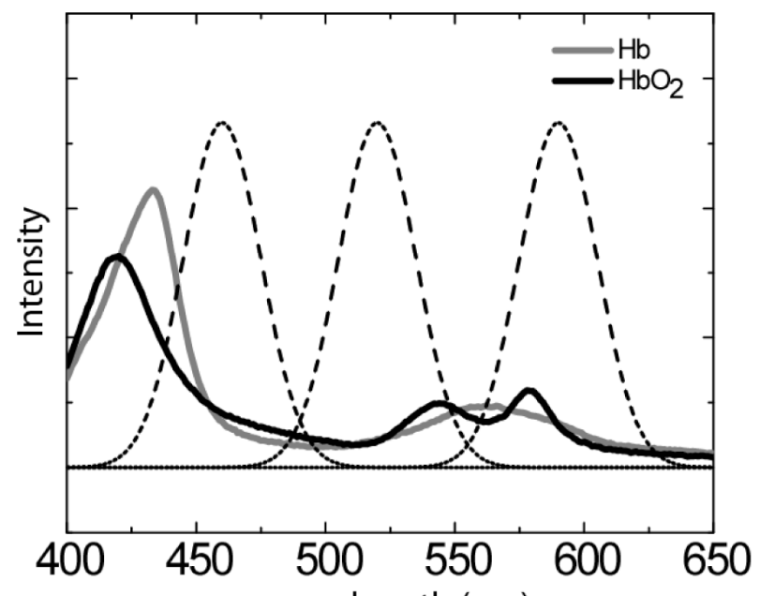
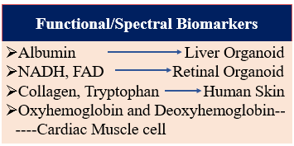
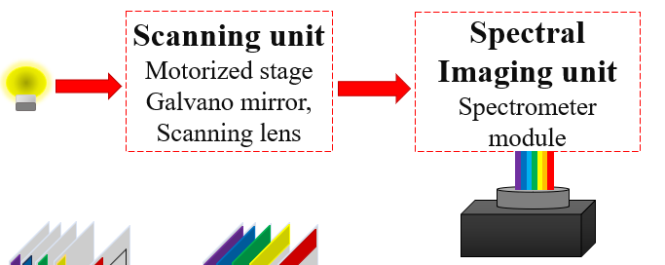







Tissue
400 450 500 550 600 650
 | Functional/Spectral biomarkers | Organoid | Imaging Methods
1 | Albumin | Liver organoid | NIR Fluoresce imaging
2 | NADH, FAD | Retinal organoid | Multiphoton fluorescence microscopy
3 | Collagen, Tryptophan | Human Skin | confocal reflection microscopy
4 | Oxyhemoglobin and deoxyhemoglobin | skeletal muscle cells, cardiac muscle cells | HSI
5 | Glycogen, Nucleic acid, lipids | Cortical Organoid | Raman Spectroscopy
Tissue
Tissue
Photodiode (spectral data unit)
Spectral detector unit

Slide 3
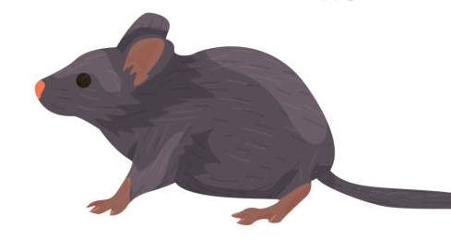
Design of a Confocal Hyperspectral Scanning Microscope for
Label-Free Multiscale Structural and Spectral Imaging
1. Testing a newly developed drug, toxicology, disease
modelling usually done in animal model before testing in
human.
¹Pratik Dhar and ^{2, #}Suchandra Banerjee
^{1,2} Amity Institute of Applied Science, Amity University, Noida, Uttar Pradesh
INTRODUCTION
Design of Hyperspectral Microscope
Hb
Intensity
HbO2
NADH
Collagen
200
250
300
350
400
450
500
550
600
650
Wavelength
RESULT AND DISCUSSION
200

Slide 4
Design of a Confocal Hyperspectral Scanning Microscope for
Label-Free Multiscale Structural and Spectral Imaging
1. Testing a newly developed drug, toxicology, disease
modelling usually done in animal model before testing in
human.
¹Pratik Dhar and ^{2, #}Suchandra Banerjee
^{1,2} Amity Institute of Applied Science, Amity University, Noida, Uttar Pradesh
INTRODUCTION
Design of Hyperspectral Microscope
Hb
Intensity
HbO2
NAP
Collagen
200
250
300
350
400
450
500
550
600
650
Wavelength
RESULT AND DISCUSSION
200

Slide 5
Design of a Confocal Hyperspectral Scanning Microscope for
Label-Free Multiscale Structural and Spectral Imaging
¹Pratik Dhar and ^{2, #}Suchandra Banerjee
^{1,2} Amity Institute of Applied Science, Amity University, Noida, Uttar Pradesh
INTRODUCTION
Design of Hyperspectral Microscope
Detector
Y
Grating
X
Spectra of (X1,Y1) spatial position
Intensity
λ
Wavelength
HSI records a three-dimensional dataset called hypercube, with two spatial dimensions (x, y) and one spectral dimension (λ).
Each pixel of HSI captured image possess a unique spectral signature referred as “Finger print”.
Existing HSI approach
RESULT AND DISCUSSION
Filter based HSI
Snapshot based HSI
Confocal HSI
Slow and band by band acquisition
Bulky optics
photobleaching
Spatial scanning Method
Limited for dynamic sample
Spatial-Spectral resolution trade off
Not suitable for live sample
Scanning unit
Galvano mirror, Scanning lens
Spectral Imaging unit
Spectrometer
Detector unit
Point Scanning
Line Scanning
High spectral resolution
Why point scanning?

Slide 6



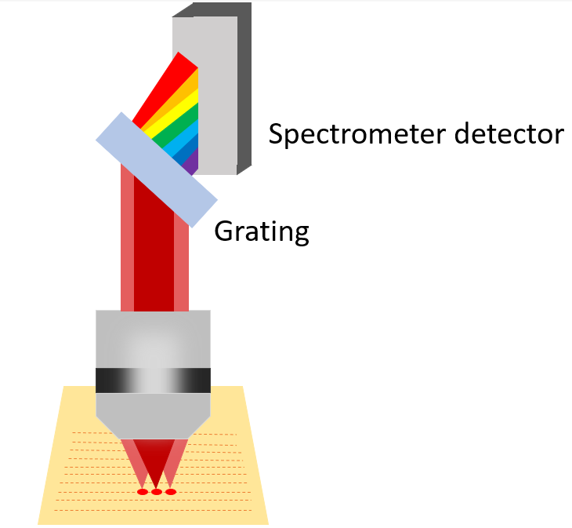
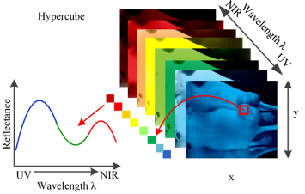
Design of a Confocal Hyperspectral Scanning Microscope for
Label-Free Multiscale Structural and Spectral Imaging
¹Pratik Dhar and ^{2, #}Suchandra Banerjee
^{1,2} Amity Institute of Applied Science, Amity University, Noida, Uttar Pradesh
INTRODUCTION
OBJECTIVE
To develop a level free hyperspectral imaging system that overcome
the limitation of existing architecture by enabling high speed spatial
scanning and spectral detection.
The existing HSI architectures are filter-based systems (LCTF/AOTF) rely on sequential band-by-band filtering makes the system slow with low spectral resolution, unsuitable for live/dynamic samples
RESULT AND DISCUSSION
Each pixel of HSI captured image possess a unique spectral signature referred as “Finger print”.
HSI records a three-dimensional dataset called hypercube, with two spatial dimensions (x, y) and one spectral dimension (λ).

Slide 7
Design of a Confocal Hyperspectral Scanning Microscope for
Label-Free Multiscale Structural and Spectral Imaging
¹Pratik Dhar and ^{2, #}Suchandra Banerjee
^{1,2} Amity Institute of Applied Science, Amity University, Noida, Uttar Pradesh
INTRODUCTION
Each pixel of HSI captured image possess a unique spectral signature referred as “Finger print”.
HSI records a three-dimensional dataset called hypercube, with two spatial dimensions (x, y) and one spectral dimension (λ).
OBJECTIVE
To develop a level free hyperspectral imaging system that overcome
the limitation of existing architecture by enabling high speed spatial
scanning and spectral detection.
The existing HSI architectures are filter-based systems (LCTF/AOTF) rely on sequential band-by-band filtering makes the system slow with low spectral resolution, unsuitable for live/dynamic samples
RESULT AND DISCUSSION

